Slide 1

Real-time Stock Price Analysis
Presented by:
Nirmala Regmi
Aishwarya Karki
Sujata Gurung
Sijal Shrestha
Prawesh Pokharel

Slide 2

Confluent Kafka: Producer & Consumer Overview
Why Kafka?: Kafka enables real-time data streaming, allowing applications to process vast amounts of data with low latency, scalability, and fault tolerance.
Producer: Sends data (messages) to Kafka topics divided into partitions for scalability. It serializes data and pushes it to Kafka brokers.
Consumer: Reads data from Kafka topics, processes it, and tracks the offset to resume consumption. Consumers are grouped for parallel processing.
Key Components:
Kafka Brokers: Manage storage and delivery of messages.
Producer API: Interface to send messages to Kafka.
Consumer API: Interface to read messages from Kafka.
Schema Registry: Ensures data consistency with predefined schemas.

Slide 3
Steps
Step up Pyspark Streaming in Databricks
Read Data from Kafka
Data Processing and analysis in real-time
Set Up Kafka For Streaming Stock Data
Define Schema For Stock Price Data
Streaming Data Sink and Visualization
Batch Processing for Daily Summary

Slide 4
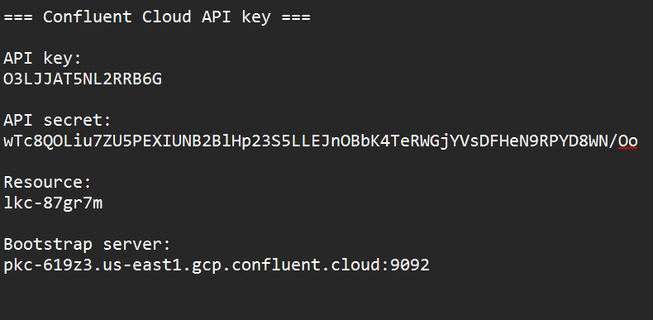
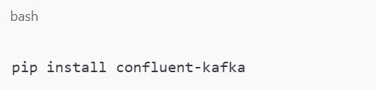
Set Up Kafka For Streaming Stock Data
Kafka Installation:
Create an account in Confluent.
Create a Kafka Cluster.
Create topic.
Download API From Topic:
Set up Kafka Configuration.
Use Confluent's Kafka API credentials (e.g., bootstrap server, API key, secret) to configure your producer or consumer.
Start Working.
www.reallygreatsite.com

Slide 5
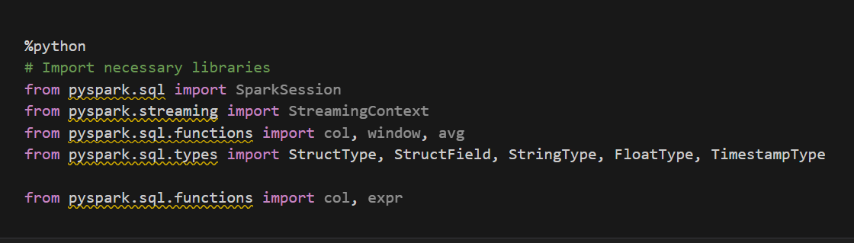
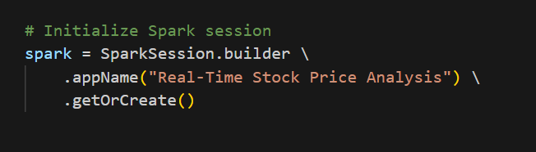
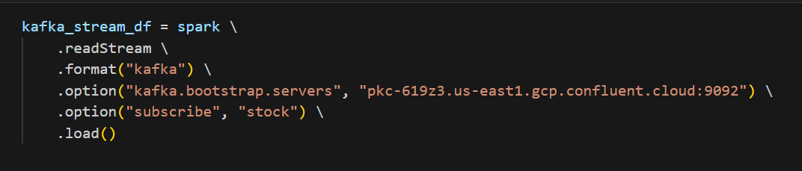
Step up Pyspark Streaming in Databricks
Import Libraries:
Configure Spark Session for Kafka
Set up the Spark session to enable Kafka support:
Kafka Integration:
Add the Kafka configurations to the Spark session
www.reallygreatsite.com

Slide 6
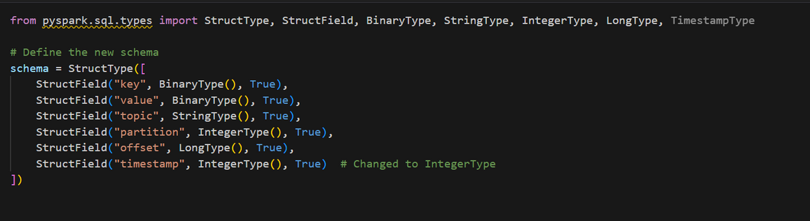
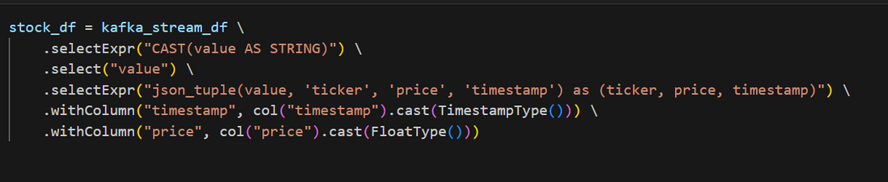
Define Schema For Stock Price Data
Why define Schema:
Defining a schema helps structure the incoming data, making it easier to parse, validate, and query the data in Spark.
It provides more efficient processing by explicitly specifying data types and column names.
Define Schema for Incoming Stock Data
Use StructType and StructField to define a schema for the stock price data to simplify parsing and querying in Spark:
Apply the Schema to Incoming Data:
Use the defined schema when reading data from Kafka to ensure structured data:

Slide 7
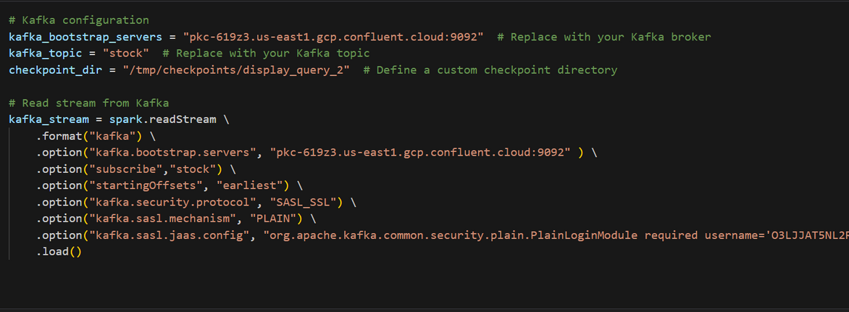
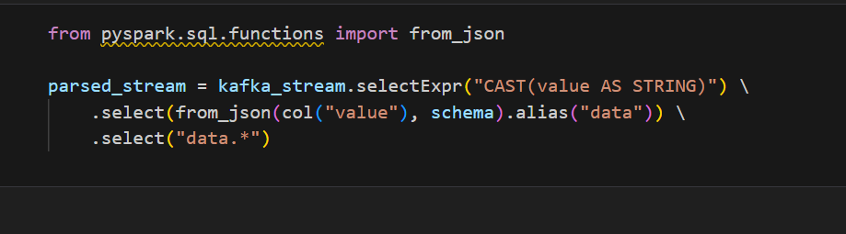
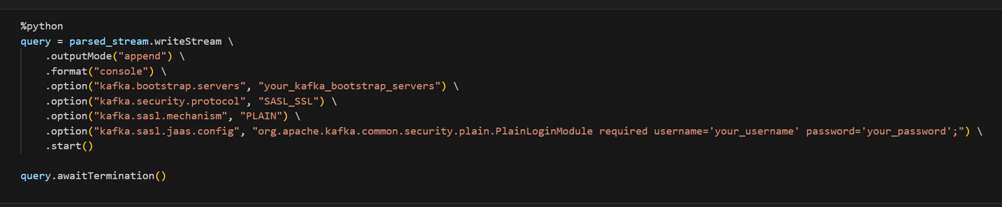
Read Data from Kafka
Kafka Consumer in pyspark:
Set up PySpark to read data from the Kafka topic by using the Kafka integration in Spark:
Parse JSON Data
Convert the raw JSON string data into a structured format by applying the schema to the Kafka stream:
Why Parse JSON?
Kafka messages are typically in raw byte format (often JSON), and parsing it into a structured format (like a DataFrame) allows for efficient querying, filtering, and processing in Spark.
Stream Processing
Once the data is parsed, you can perform operations like aggregations, filtering, and transformations on the stock data:
www.reallygreatsite.com

Slide 8
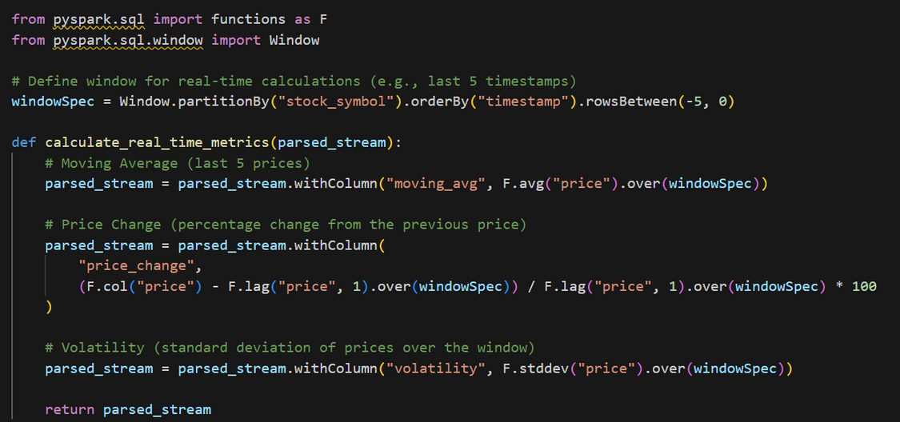
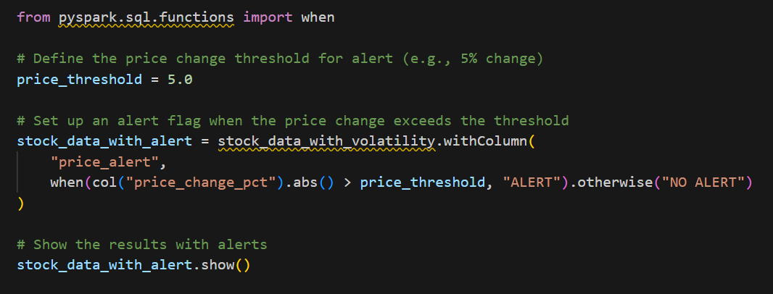
Data Processing and analysis in real-time
Calculating Real-Time Metrics
Moving Averages: Calculate a rolling window average to smooth out stock price fluctuations and observe trends over time.
Price Change: Calculate the percentage change in stock price over time.
Volatility: Measure how much the stock price fluctuates within a given time window.
Real-Time Alerts
Price Condition Alerts: Set up alerts to trigger when the stock price changes significantly (e.g., by 5% in a short period). Example of setting up a 5% drop alert:

Slide 9
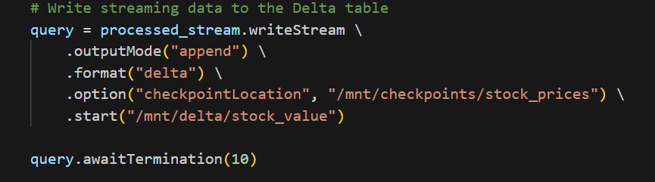
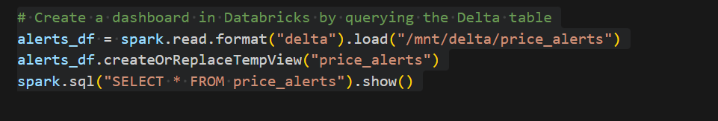
Streaming Data Sink and Visualization
Create to Delta Table
Write to a Delta Table: Write the data, including metrics and alerts, to a Delta table for persistent storage and easy querying:
Visualize Real-Time Data
Real-Time Dashboards: In Databricks, create a dashboard to visualize the moving average, price change, and alert data:
Matplotlib Visualization: For local visualizations, use ‘matplotlib’ to create live charts of stock data metrics, such as moving averages or volatility.
www.reallygreatsite.com

Slide 10
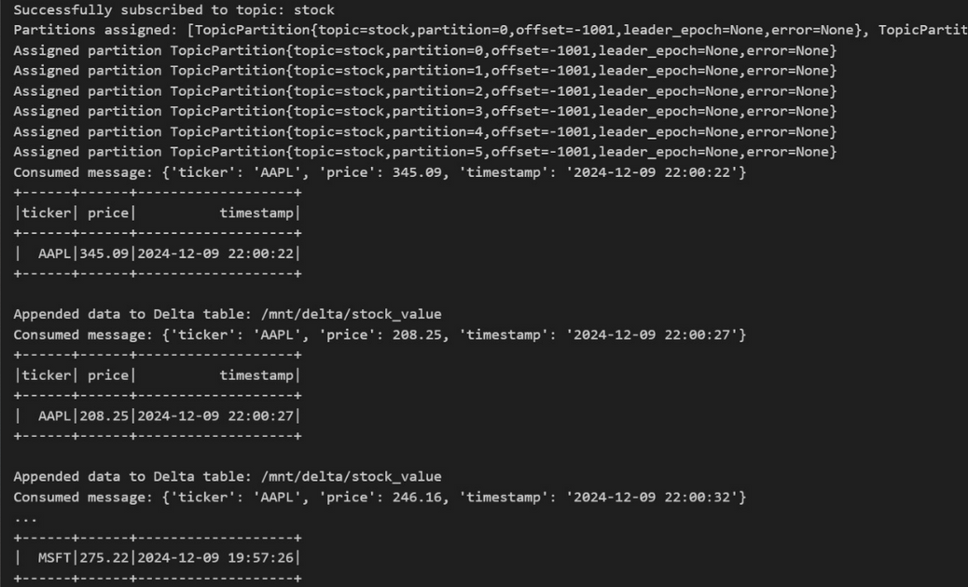
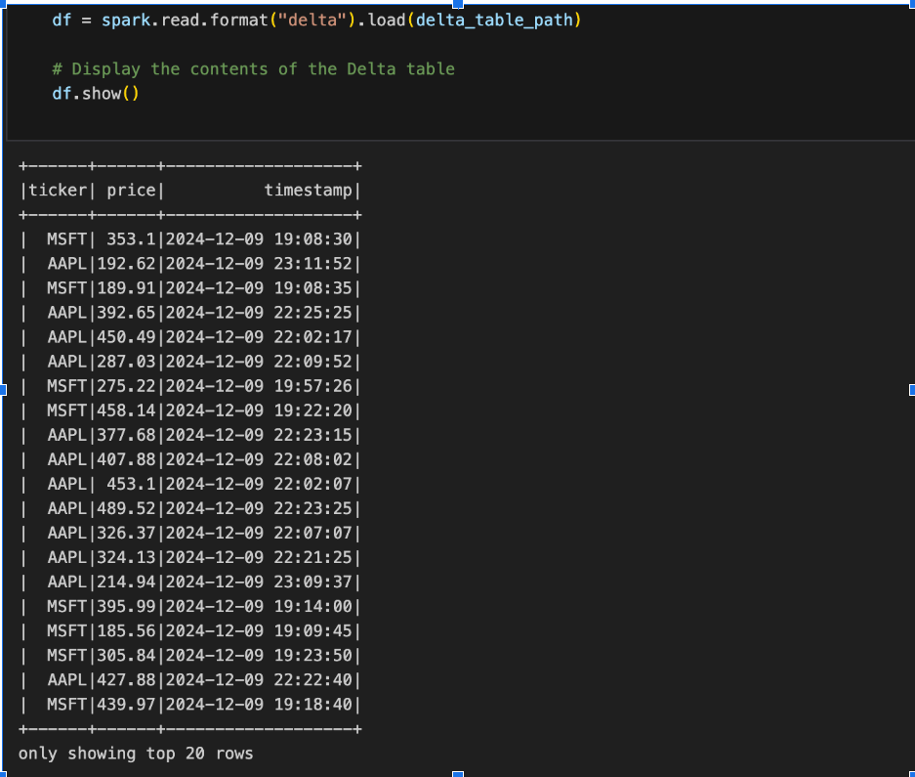
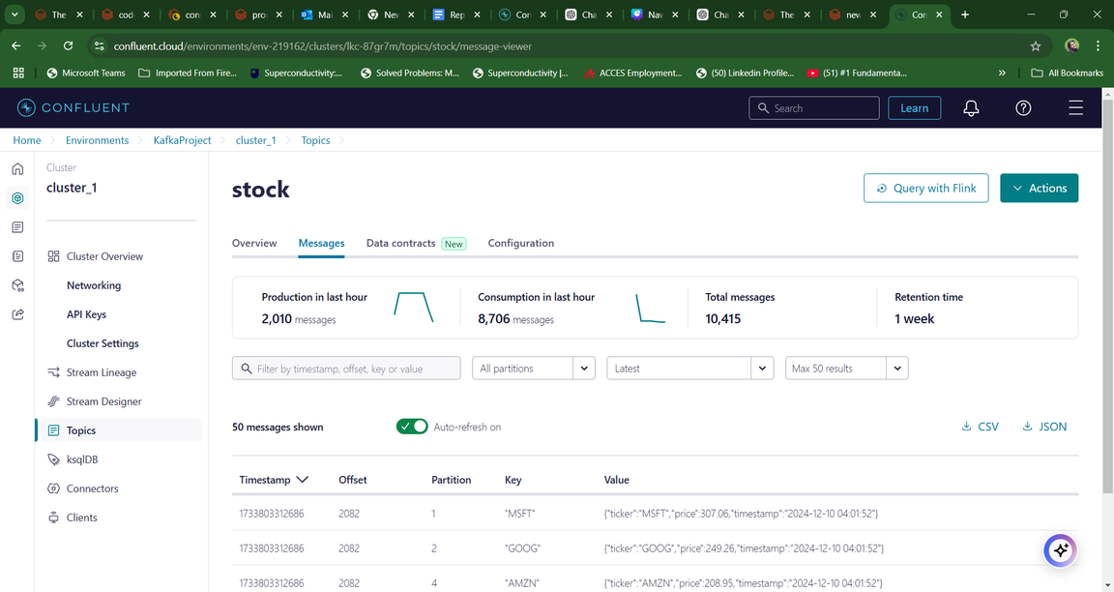
Streaming Data Sink and Visualization

Slide 11
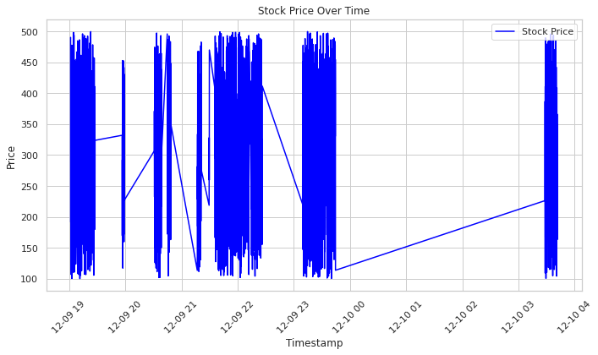
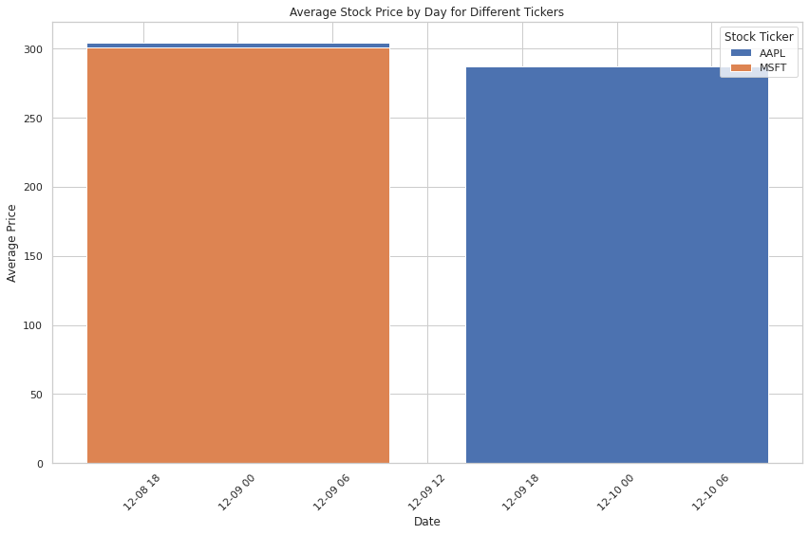
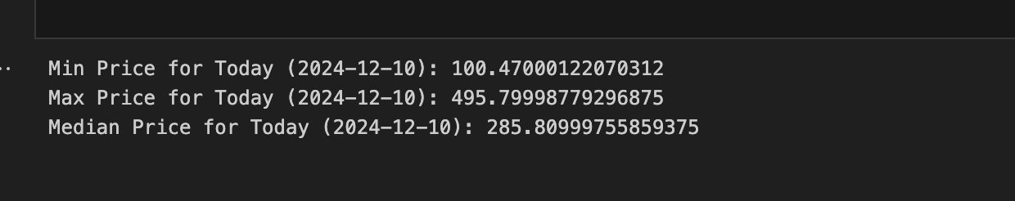

Slide 12

Batch Processing for Daily Summary
Daily Summary Aggregation:
Calculate average, minimum, and maximum prices.
Total traded volume per day.
Count of significant price changes (e.g., > 5%).
Storage of Summaries:
Save summaries in Delta tables or relational databases for historical analysis.
www.reallygreatsite.com

Slide 13

Challenges & Solutions
Schema Evolution:
Challenge: Managing changes in data streams.
Solution: Use Confluent's Schema Registry for control.
Real-Time Latency:
Challenge: Processing large data streams in real-time.
Solution: Optimize PySpark with partitioning and caching.
Distributed Monitoring:
Challenge: Debugging distributed setups.
Solution: Use Confluent monitoring tools.

Slide 14
Future Enhancements
Machine Learning Integration
Cloud Deployment
Implement predictive analytics using ML models for real-time stock forecasting and anomaly detection.
Scale pipelines with cloud-native tools like AWS, Azure, or GCP for high availability and seamless data stream scaling.
Multi-Market Integration
Enhanced Visualization
Expand the pipeline to support multiple stock markets and incorporate diverse financial instruments for broader analysis.
Develop interactive dashboards with drill-down features, real-time filters, comparisons, and custom views for deeper insights.
www.reallygreatsite.com

Slide 15


Conclusion
Demonstrated a scalable, real-time stock analysis solution using Kafka and PySpark.
Enabled real-time metrics, actionable alerts, and robust data visualization.
Provided practical applications for monitoring stock performance and market trends.
Established a foundation for integrating advanced analytics and predictive modeling.
Delivered a flexible solution to support high-frequency trading and decision-making.
Highlighted the potential of leveraging big data for innovative financial solutions.

Slide 16

Questions

